Slide 1
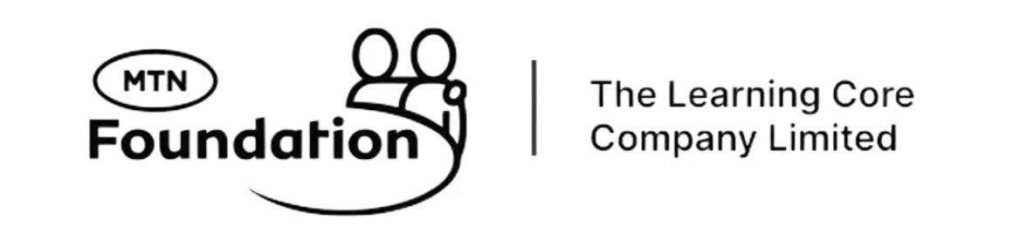
Week 4: Sales and Growth Systems
Go From Visibility to Actual Online Sales

Slide 2

RELYING ON SOCIAL MEDIA ALONE FOR YOUR BUSINESS IS RISKY
While social media offers a wide reach, it's important to diversify your digital presence. Platforms change algorithms, ownership, and policies, which can impact your direct connection with customers. Building your own channels like email lists and websites ensures more control and long-term stability for your sales and growth systems.

Slide 3
Understanding Your Customer's Journey
01
02
03
Awareness
Interest
Consideration
Customer discovers your business through Google, social media, or referral
They visit your landing page or social profiles to learn more about your products
They compare your offerings, read reviews, and evaluate if you meet their needs
04
05
Purchase
Repeat & Referral
They reach out via WhatsApp or email to place an order and complete payment
Satisfied customers return for more and recommend your business to others

Slide 4
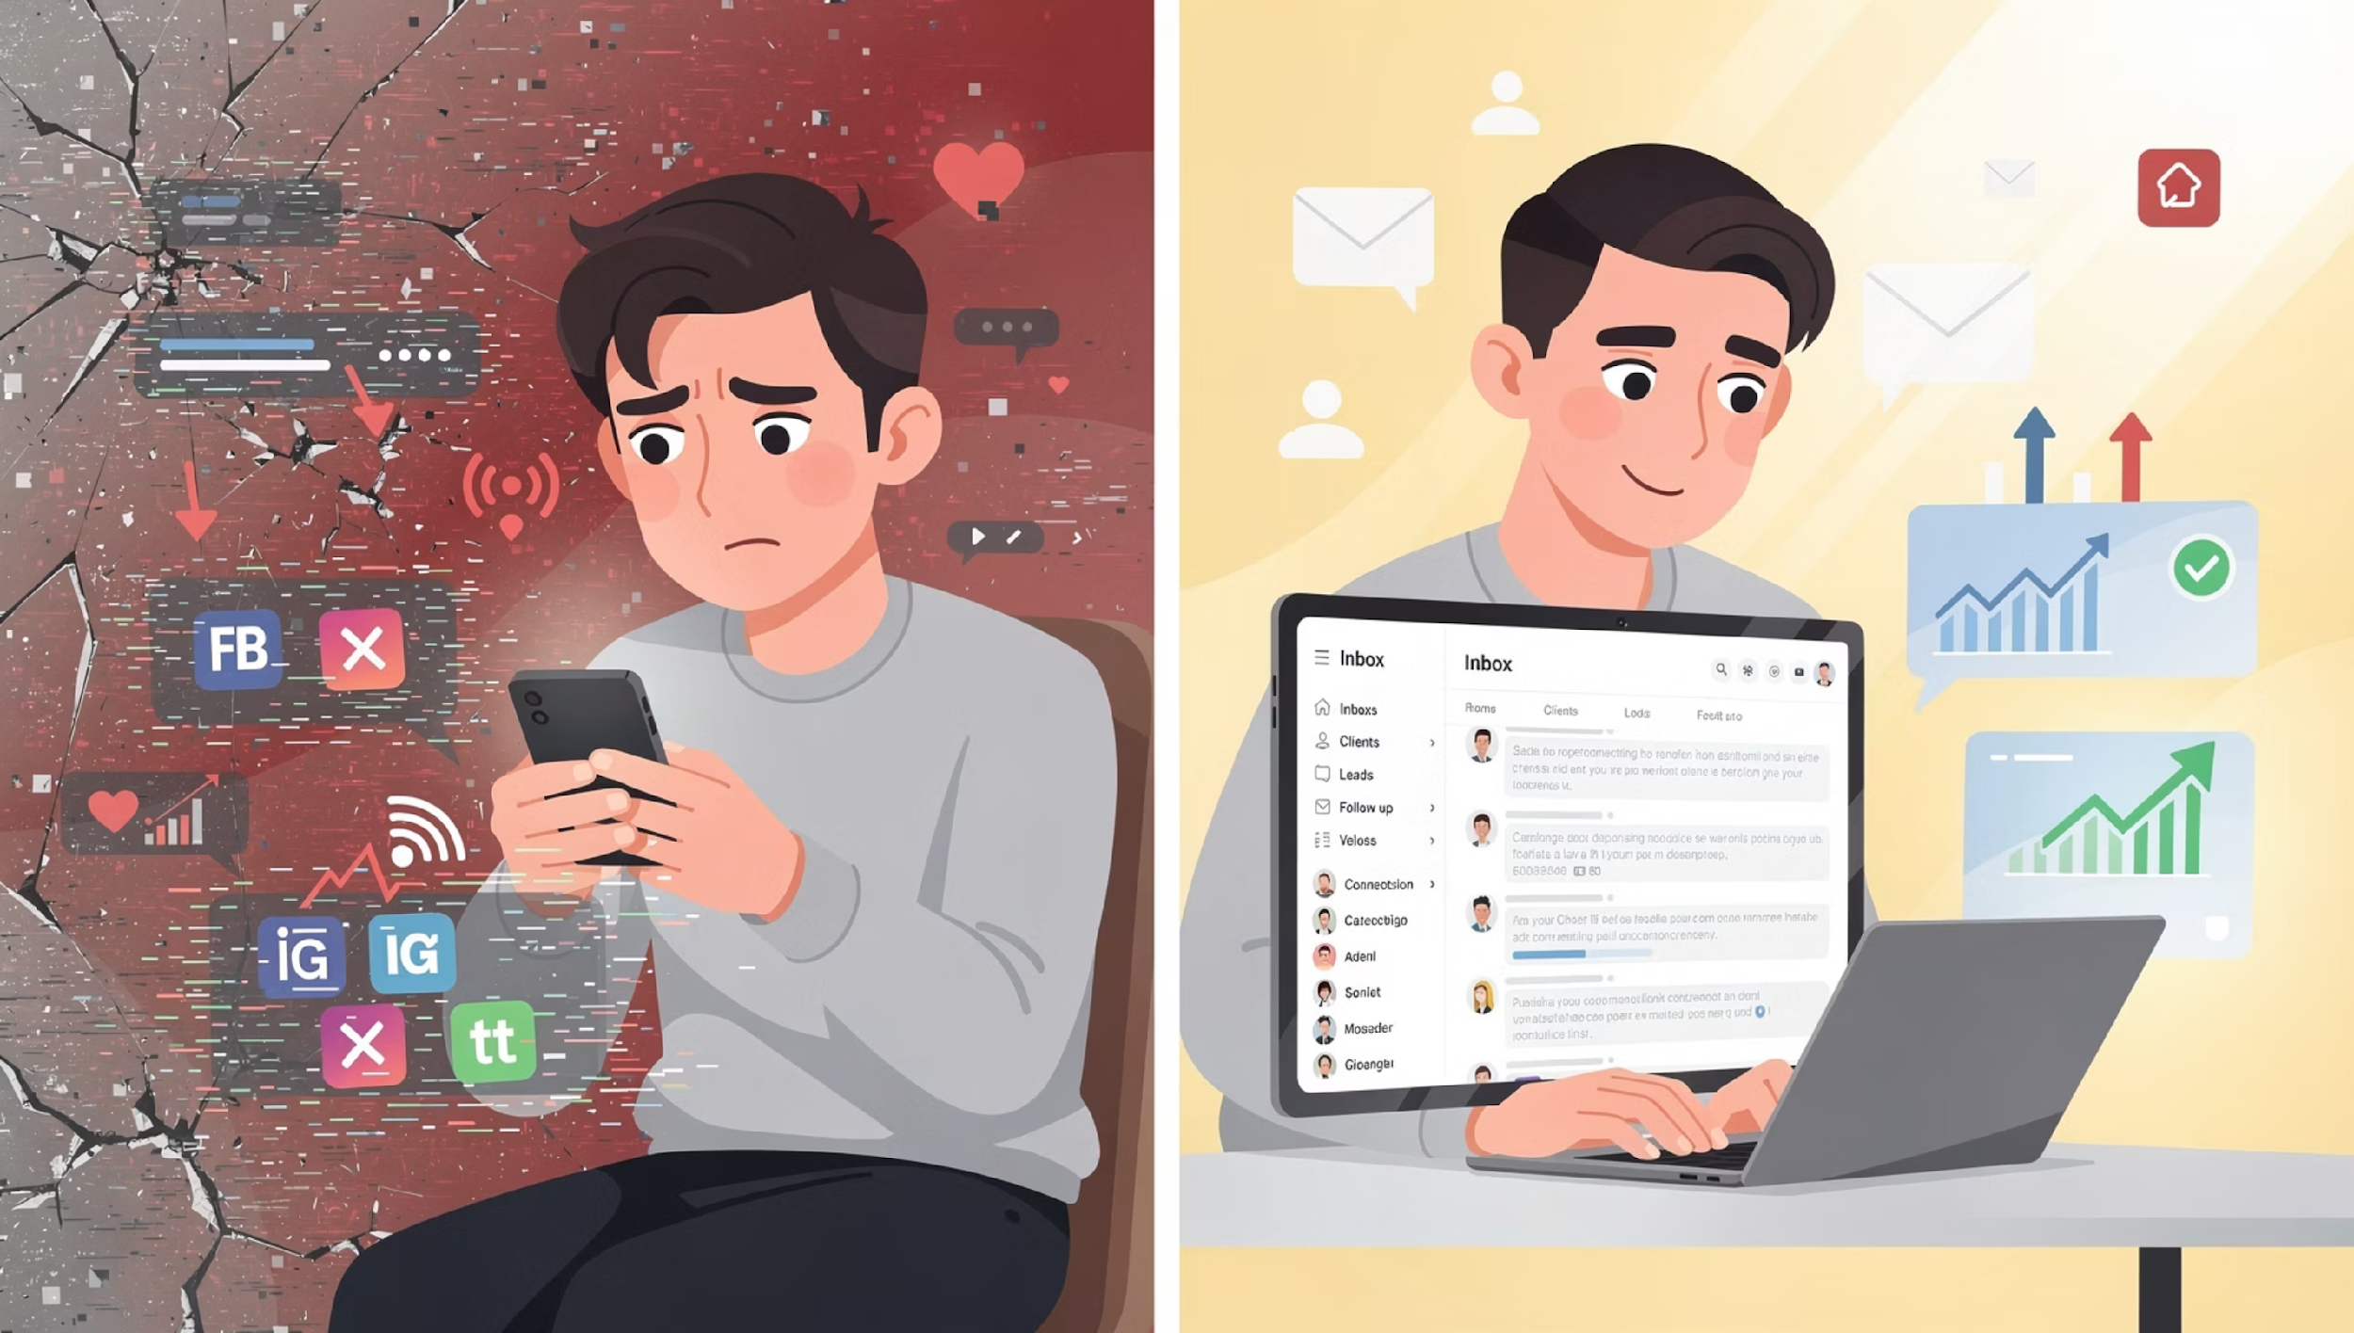

Slide 5
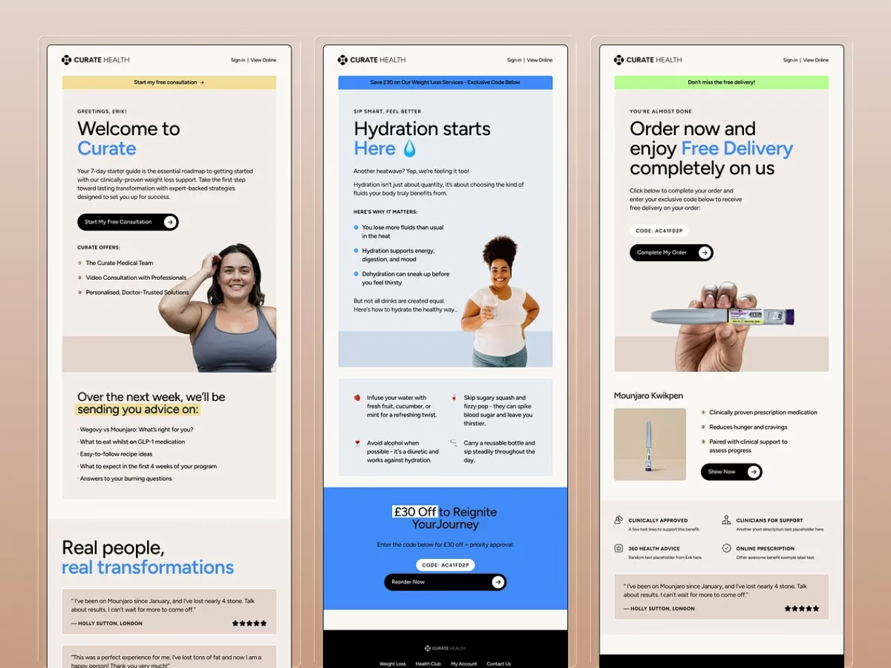
EMAIL MARKETING FOR BUSINESS
Email marketing is the practice of using email to promote products, services, and build relationships with customers. It is important for businesses because it is a cost-effective, high-ROI marketing tool that drives sales, increases brand awareness, and fosters customer loyalty.

Slide 6
Why Email Marketing is Important for Businesses
High ROI: Email marketing often has a high return on investment compared to other channels due to its low cost and ability to drive direct sales.
Drives sales and conversions: It is an effective channel for promoting special offers and guiding potential customers through the sales funnel, with a higher conversion rate than social media.
Increases brand awareness: Regular communication through emails keeps a brand at the forefront of customers' minds and helps build brand loyalty.
Direct access to customers: Unlike social media, email provides a direct line to a customer's inbox, bypassing algorithms and ensuring messages are seen.
Measurable: It is a highly measurable channel, with tools that provide data on open rates, clicks, and other key metrics to help businesses refine their campaigns.

Slide 7
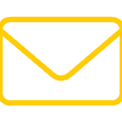


Essential Tools for Your Email Marketing Strategy
Choosing the right email marketing platform is crucial for the success of your campaigns. Here are some popular options, each with unique strengths to suit different business needs:
Mailchimp
Constant Contact
ActiveCampaign
A popular, user-friendly platform ideal for beginners and small businesses. Offers intuitive email builders, audience segmentation, basic automation, and reporting tools to get started with email marketing effectively.
Renowned for its simplicity and excellent customer support, making it great for growing businesses and non-profits. Features include customizable templates, event management tools, and social media integration.
A powerful solution for businesses needing advanced marketing automation and CRM capabilities. Perfect for creating complex sales funnels, highly personalized customer journeys, and deep segmentation.

Slide 8
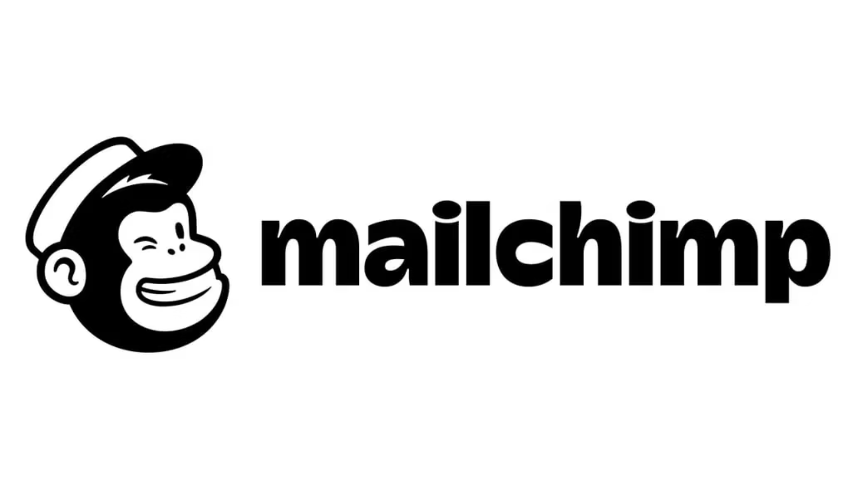
INTRODUCTION TO MAILCHIMP
To use Mailchimp, first, create an account and set up your audience by importing contacts. Then, click "Create" to build a regular email campaign, naming it and setting the recipients, "from" information, subject line, and preview text. Design your email using the new drag-and-drop builder and a template, customize the content, and finally, schedule or send it immediately and review the reports to see its performance.

Slide 9
HOW TO SET IT UP:
Set up your account and audience
Sign up for an account: Go to Mailchimp, provide your details, and activate your account via the email you receive.
Set up your audience: After logging in, create an audience by importing your contacts manually or by uploading a file.
Create a signup form: Customize a signup form to collect new subscribers
2. Create an email campaign
Start a new campaign: Click "Create" and select "Email" followed by "Regular".
Name the campaign: Give your campaign an internal name to help you keep track of it.
Set up the "To" and "From": Choose your recipients from your audience and verify that the "from" email address is correct.
Add a subject and preview text: Craft a compelling subject line and add preview text to encourage opens.

Slide 10
HOW TO SET IT UP:
3. Design and send your email
Choose a template: Use the drag-and-drop editor to select and customize a pre-designed template.
Add your content: Drag blocks for text, images, and buttons into your email layout, and then edit them to fit your needs.
Preview and send: Preview your email to check how it looks on desktop and mobile. Once you're satisfied, either send it immediately or schedule it for a later time.
4. Analyze your results
View reports: After sending, check the campaign reports to see metrics like open rates, click rates, and unsubscribes.
Refine your strategy: Use this data to improve your future email campaigns.

Slide 11
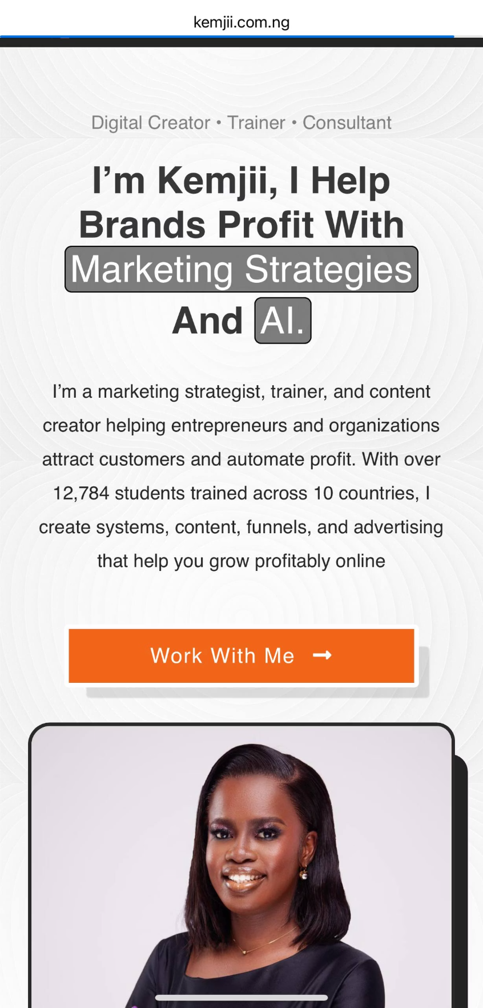
LANDING PAGE FOR BUSINESS
A landing page is a stand alone web page designed for a specific marketing campaign, acting as the "landing" spot for visitors who click an ad, email link, or other digital promotion.
It is important because its single-focus design, free from distractions, leads to higher conversion rates, better lead generation, and a more effective marketing funnel.

Slide 12
WHY IT IS IMPORTANT:
Increased conversion rates: By focusing on a single goal, landing pages are highly effective at getting visitors to take the desired action, such as filling out a form or completing a purchase.
Better lead generation: They are ideal for capturing visitor information in exchange for valuable content, providing a clear path for lead generation.
Improved ad performance: Landing pages allow you to match your ad copy and design to the content on the page, creating a seamless experience that can lead to lower costs per conversion.
Targeted messaging: You can create different landing pages for different audiences or campaigns, providing a more personalized and relevant experience for each visitor.
Easier to test and optimize: The single-page, single-goal structure makes it simpler to test different headlines, images, and calls to action to improve performance over time.

Slide 13
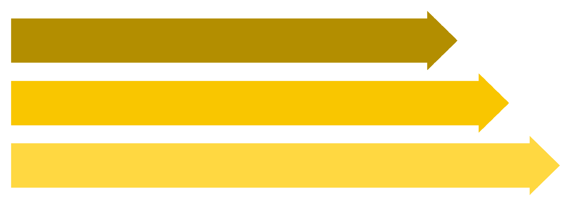
From Social Media to Community
Social Reach
Engage & Convert
Owned System
Let's connect the dots from social media setup to building your subscriber list.

Slide 14
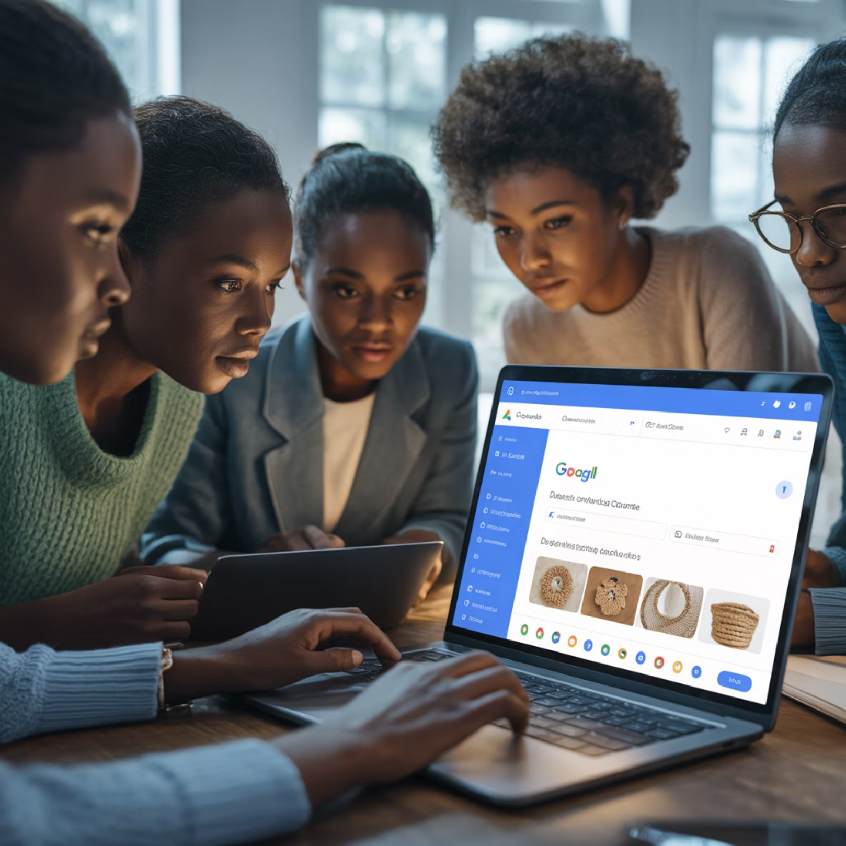
WEEK 4
CLASS ACTIVITY
Design a landing page for your business
Create an account on Mailchimp
Copy and paste your landing page link.

